Slide 1
Ancyclostoma duodonale
Mamita Rai Gurung

Slide 2
Introduction
Parasitic nematode worm and commonly known as Old World hookworm.
It lives in the small intestine of hosts such as humans, cats and dogs, where it is able to mate and mature.
Two hookworms:
Ancylostoma duodenale (Old World hookworm).
Necator americanus (New world hookworm)

Slide 3
Contd.....
Ancylostoma duodenale is small cylindrical worm, greyish-white in color. It has two ventral plates on the anterior margin of the buccal capsule. Each of them has two large teeth that are fused at their bases. A pair of small teeth can be found in the depths of the buccal capsule.
Males are 8 mm to 11 mm long with a copulatory bursa at the posterior end.
Females are 10 mm to 13 mm long, with the vulva located at the posterior end.
Females can lay 10,000 to 30,000 eggs per day. The average lifespan of Ancylostoma duodenale is one year.
Posses two larval form rhabditiform and filarialform

Slide 4
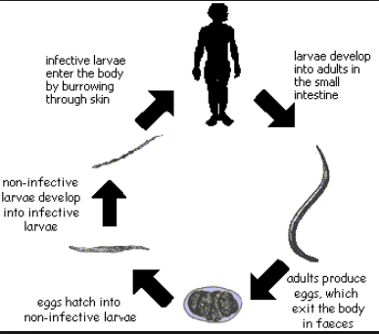
Life cycle

Slide 5
Contd.....
When a filariform larva (infective stage) penetrates the intact skin, the larva enters the blood circulation.
It is then carried to the lungs, coughed up, and swallowed back into the small intestine.
The larva later matures into an adult in the small intestine and female worms can lay 25,000 eggs per day.
The eggs are released into the feces and reside on soil. Embryonated eggs on soil will hatch into juvenile 1 stage (rhabditiform or noninfective stage) and mature into filariform larvae.
The filariform larvae can then penetrate another exposed skin and begin a new cycle of infection.

Slide 6
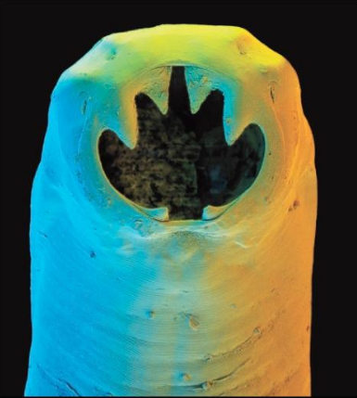
Transmission
Through feacal oral route
Through soil

Slide 7
Pathogenesis
Filariform larva (infective stage) penetrates the intact skin and enters the blood circulation.
It is then carried to the lungs, coughed up, and swallowed back into the small intestine.
It attaches to the cells of small intestine, causes damages with loss of blood.
About 0.1-0.3 ml blood is loss by per worm per day.

Slide 8
Clinical manifestation
Light infection causes abdominal pain, loss of appetite
Heavy infection causes severe protein deficiency or iron deficiency anemia.
Protein deficiency may lead to dry skin, edema and potbelly, while iron deficiency anemia might result in mental dullness and heart failure.

Slide 9
Laboratory Diagnosis
Sample: stool and larve
Microscopically eggs in stool as well as eosinophils by Concentration method using the formalin–ethyl acetate sedimentation technique and wet mount of the sediment
Ocult blood in stool
Where concentration procedures are not available, a direct wet mount examination of the specimen is adequate for detecting moderate to heavy infections. For quantitative assessments of infection, various methods such as the Kato-Katz can be used.
Cutaneous larval migrants is usually diagnosed clinically, Larvae may be seen in stained tissue sections

Slide 10
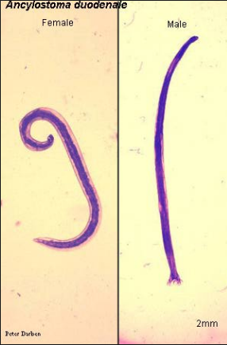
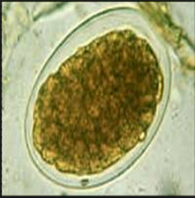

Slide 11
Prevention
Education, improved sanitation and controlled disposal of human feces are important.
Wearing shoes in endemic areas can reduce the prevalence of infection as well.
Treatement
Can be treated with albendazole, mebendazole and benzimidazoles.
Pyrantel pamoate is an alternative.
In severe cases of anemia, blood transfusion may be necessary.

